Slide 1

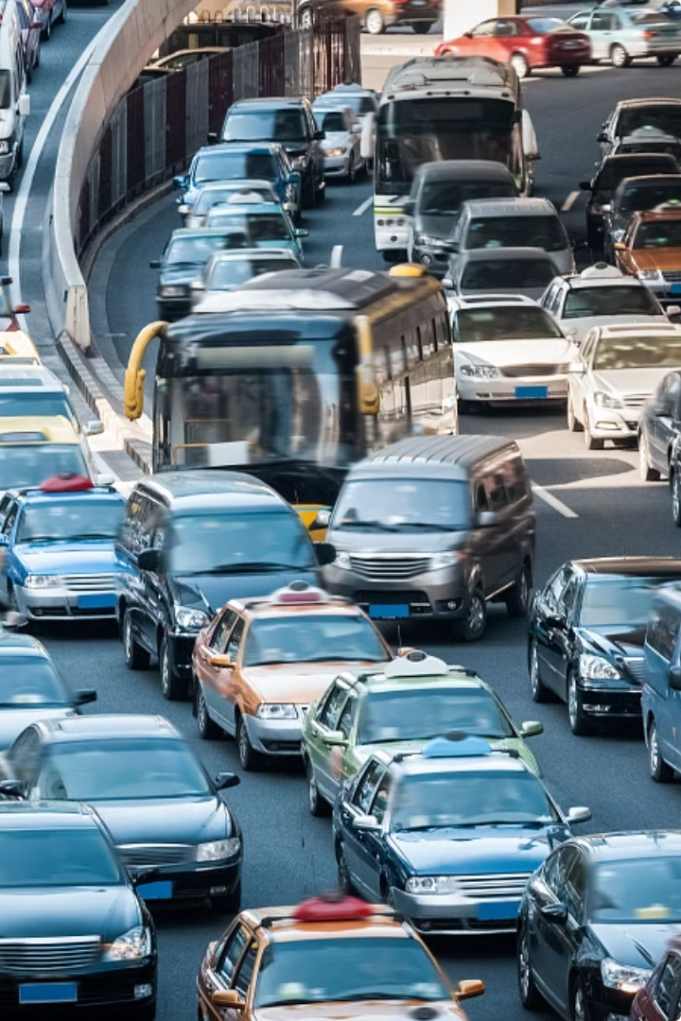
RouteEase
Revolutionizing the way we navigate urban traffic congestion.

Slide 2
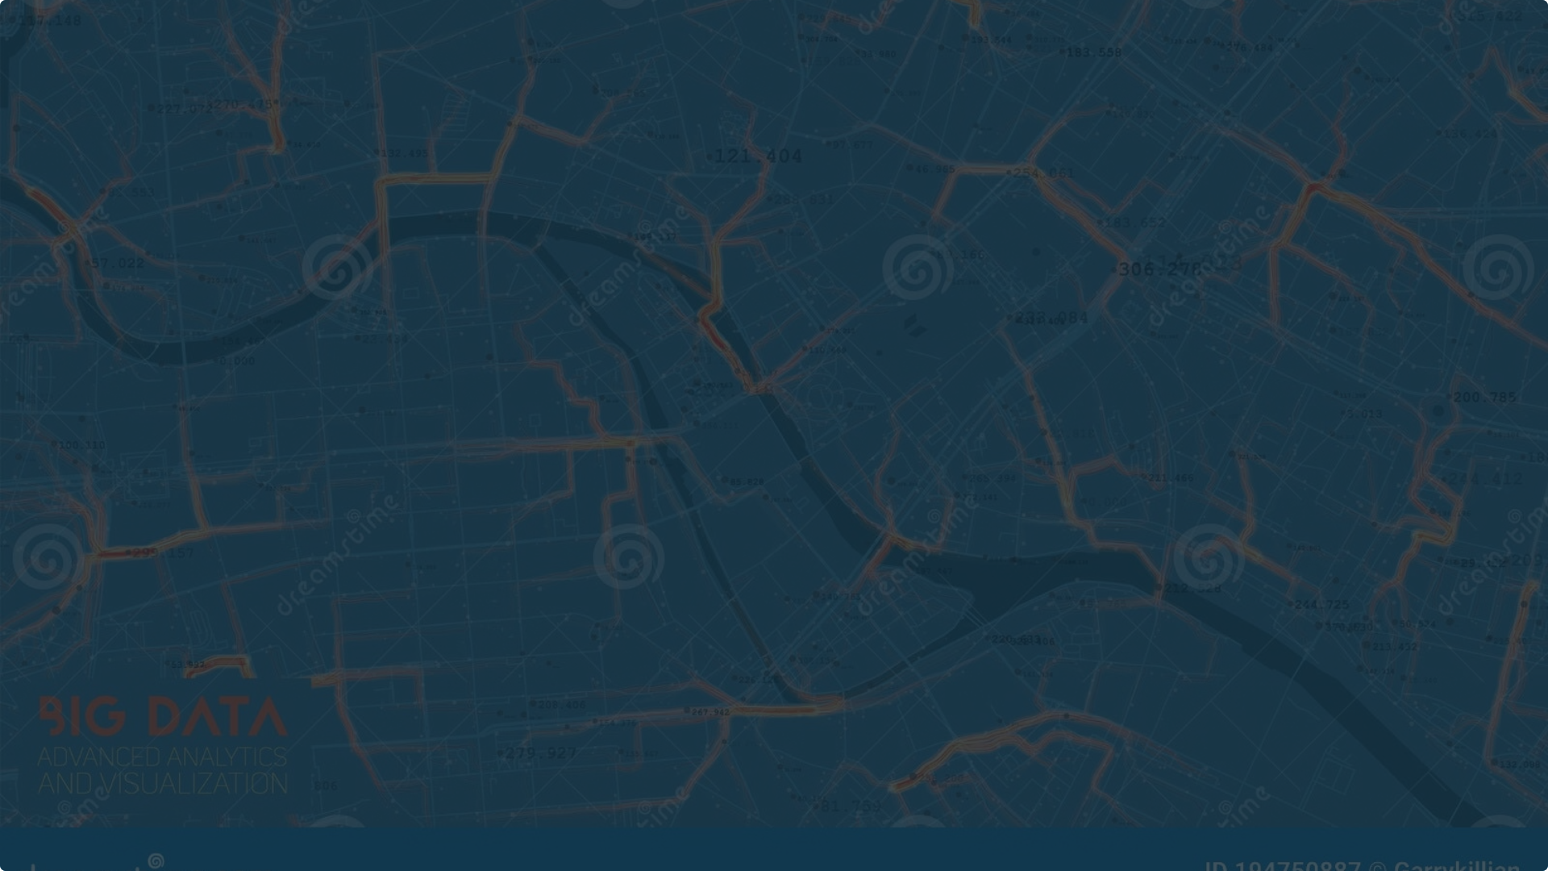
Abstract
1
Data-Driven Insights
2
User-Friendly Interface
3
Sustainable Solutions
RouteEase harnesses data to optimize traffic flows and reduce commute times.
Commuters can easily access personalized route recommendations and traffic updates.
RouteEase promotes eco-friendly transportation and decreases vehicle emissions.

Slide 3
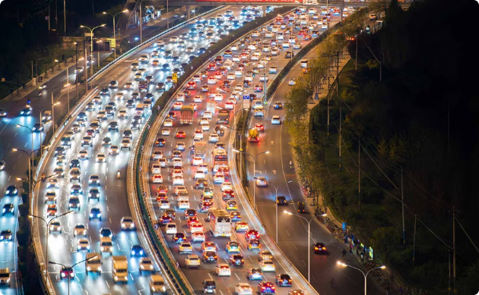
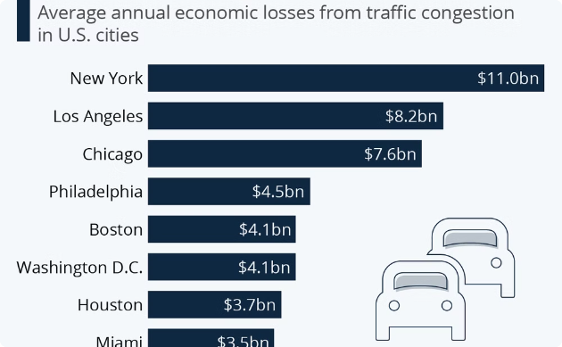
Understanding the Problem: Causes and Impacts of Traffic Congestion
Causes
Impacts
Increased vehicle ownership, urbanization, and lack of efficient public transportation.
Lost productivity, increased fuel consumption, air pollution, and driver frustration.

Slide 4

Problem Statement
Increased Vehicle Ownership
1
More cars on the roads contribute to traffic congestion.
2
Urbanization
Growing populations in cities put strain on transportation infrastructure.
Lack of Efficient Public Transit
3
Limited public transportation options force more people to drive.

Slide 5
Existing System & Proposed System
Existing System
Proposed System
Traditional traffic management relying on limited data and manual interventions.
RouteEase - AI-powered, data-driven platform for optimized traffic coordination.

Slide 6




Methodology
Data Collection
AI Analytics
Optimization
Deployment
Utilize machine learning algorithms to analyze traffic patterns and predict congestion.
Understanding the Traffic Situations at different hours
Using Flask deploy the model
Clean & Process the data

Slide 7
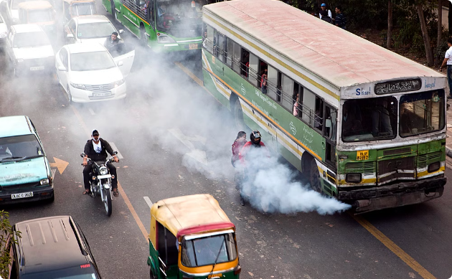
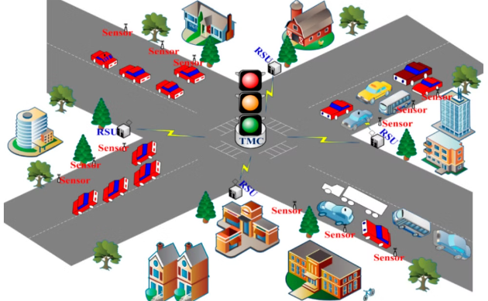
Result Analysis & Conclusion
Reduced Emissions
Improved Traffic Flow
Decreased vehicle emissions by 15%, contributing to cleaner air.
RouteEase's optimization algorithms reduced overall congestion by 20%.

Slide 8




Stakeholder Collaboration and Community Engagement
Government
Community
Transportation Agencies
Technology Partners
Partner with local authorities to integrate RouteEase into city infrastructure.
Engage with residents to understand their needs and gather feedback.
Collaborate with public transit providers to optimize multimodal solutions.
Leverage partnerships to continuously enhance the RouteEase platform.

Slide 9
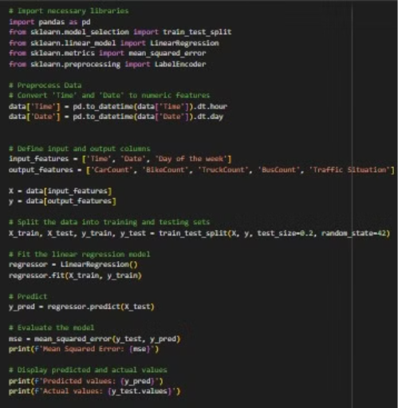
LINEAR REGRESSION

Slide 10
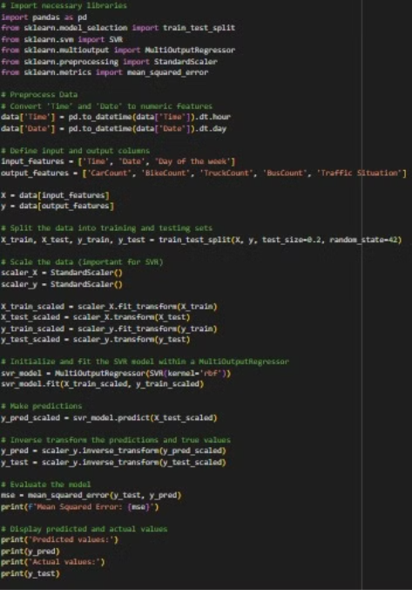
SUPPORT VECTOR REGRESSION

Slide 11
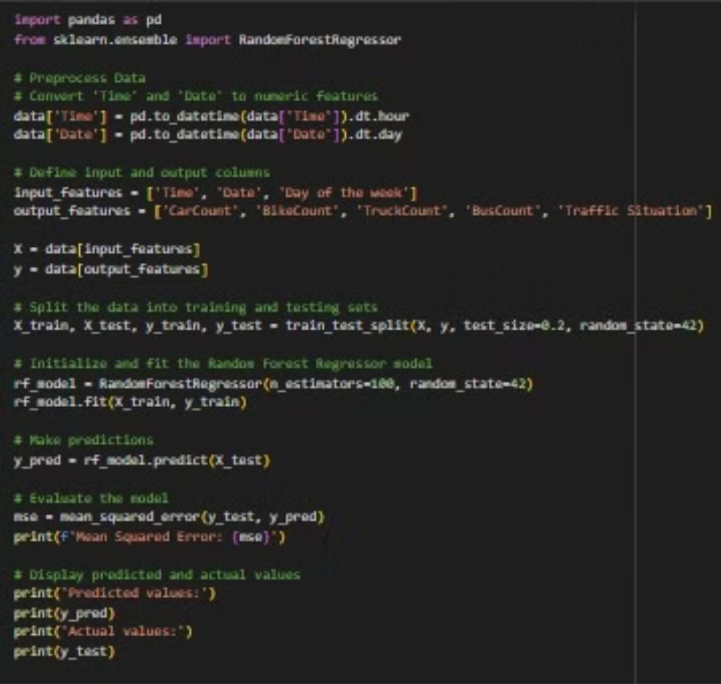
RANDOM FOREST REGRESSOR

Slide 12
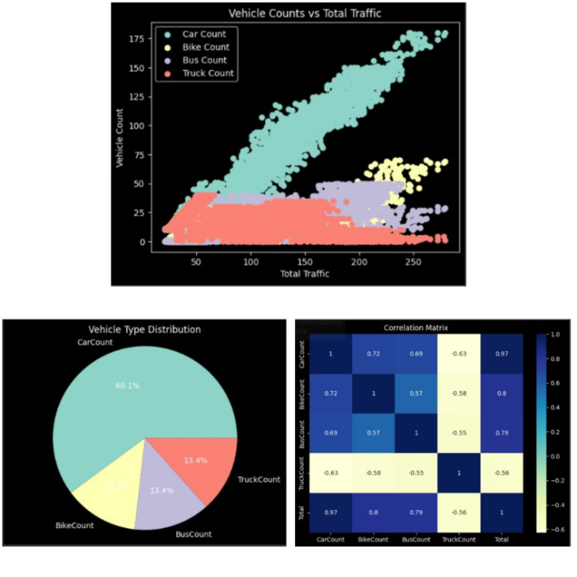
DATA VISUALIZATIONS

